Slide 1

HEALTHCARE PROVIDER FRAUD DETECTION

Slide 2




PRESENTATION ROADMAP
/01
1. BUSINESS CONTEXT
2. DATA ENGINEERING
3. MODELING
4. IMPACT
•
The $68B Problem
•
Sources & Quality
•
Handling Imbalance
•
Error Analysis
•
Fraud Types
•
Deep Cleaning
•
Algorithm Selection
•
Financial ROI
•
Objective Function
•
EDA Insights
•
Training Efficiency
•
Operational Workflow
•
Advanced Feature Eng.
•
Model Comparison
•
Future Roadmap

Slide 3




/02
THE BUSINESS CONTEXT
GOAL: PROACTIVE DETECTION
THE CURRENT STATE: "PAY AND CHASE"
CMS typically pays claims first and investigates later.
This reactive model is inefficient.
$68 Billion/Year
Estimated lost due to fraud, waste, and abuse.
Resource Constraints
Manual investigators can only review <1% of providers.

Slide 4





DATA INVENTORY
/03
BENEFICIARY DATA
INPATIENT CLAIMS
OUTPATIENT CLAIMS
138,556 Records
40,474 Records
517,737 Records
•
Demographics (Age, Race, County)
•
Admission/Discharge Dates
•
Procedure Codes
•
Chronic Conditions (11 flags)
•
Diagnosis Codes (ICD-9)
•
Visiting Physicians
•
Cost (Deductibles paid)
•
DRG Codes
•
High Volume / Low Cost
•
High Reimbursement Amounts
Labels Data
5410 Records , each has a unique provider with his status of being a Potential fraud.

Slide 5
DATA QUALITY AUDIT & CLEANING DECISIONS
/04
Feature | Issue Detected | Remediation Strategy
Deductibles | High missingness in Outpatient data. | Conditional Imputation: Inpatient defaults to $1,068 (Medicare standard). Outpatient defaults to $0.
Date Logic | 32 records where `AdmissionDt` > `DischargeDt`. | Row Substitution: These illogical records represented <0.01% of data and were dropped to preserve feature integrity.
 | 17 records where `ClaimEndDt` > DischargeDt | All those 17 Record were Fraud so we created IsPostDischargeBilling
Categorical | `RenalDiseaseIndicator` coded as 'Y'/'0'. | Cleaning: Converted to 1/0 boolean flag for model compatibility.
Gender | Coded as 1/2. | Standardization: Mapped to 0/1 logic for consistency with other binary flags.
Chronic | Coded as 1/2 | Standardization Mapped to 0/1 logic for consistency with other binary flags
DOD | Transformed to a Death Flag | Where records who didn’t have a DOD where assumed to be not dead

Slide 6
Merging Starategy
/05
After Handling the DIFFERENT columns which are present in the Inpatient data but not the Outpatient
We got 558211 records and 54 Columns

Slide 7


CLINICAL GROUPING LOGIC
/08
Handling the "Curse of Dimensionality" in Diagnosis Codes.
SOLUTION: CCS GROUPING
PROBLEM
Mapped codes to 17 Clinical Domains.
14,000+ unique ICD-9 Codes.
One-Hot Encoding would create a sparse, massive matrix that overfits easily.
•
401.9 (Hypertension) → Circulatory
•
250.0 (Diabetes) → Metabolic
•
800.0 (Fracture) → Trauma

Slide 8

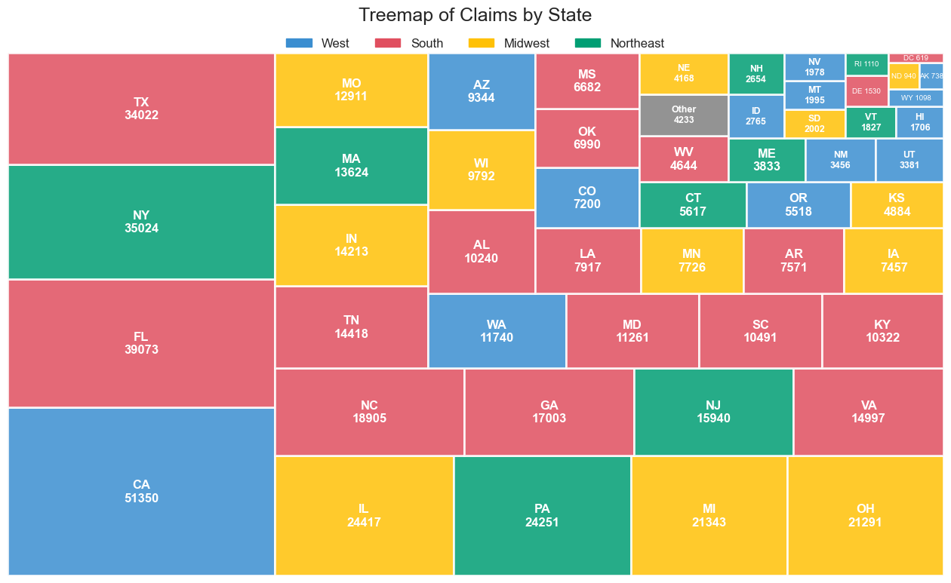
EDA: GEOGRAPHIC DISTRIBUTION
/06
Top States by Claim Volume
CONCENTRATION ANALYSIS
1. California (CA)
2. Florida (FL)
3. NewYork
*Note: While volume is high, fraud rates were distributed across states, indicating fraud is not strictly geo-locked.

Slide 9

FEATURE ENGINEERING: AGGREGATION STRATEGY
/09
FROM TRANSACTIONS TO BEHAVIOR
Since we predict fraud at the Provider Level, we flattened 550k+ claims using aggregation functions.
Raw Feature | Aggregation Function
skewed financial data | Mean, Std,P99.5
Ids | Count , N-unique, Mode Frequency
Count Data | Mean,Min , Max , Std , Sum
Demographic Data | Any , Std
Duration | Min, Max , Mean , Std
Age | Std , min , max
Flag Columns | Mean , Std , Any , All
Chronic Conditions | Sum
Sparse Variance Columns | Std
Rare Flags | Any
Many-to-One Transformaton

Slide 10



BEHAVIORAL FEATURES
/10
We engineered 100 features. Here are the top performers:
1. CLAIMDURATION_MAX
2. DIAGNOSISGROUP_COUNT
3. INPATIENT_STDDEV
The maximum length of stay recorded by a provider. Fraudsters often inflate this to the max allowed limit.
The variety of diagnosis codes used. High variance suggests "kitchen sinking" (adding codes to justify cost).
Variability in inpatient claim costs. Fraudsters often have rigid billing patterns (low variance) compared to real life.

Slide 11
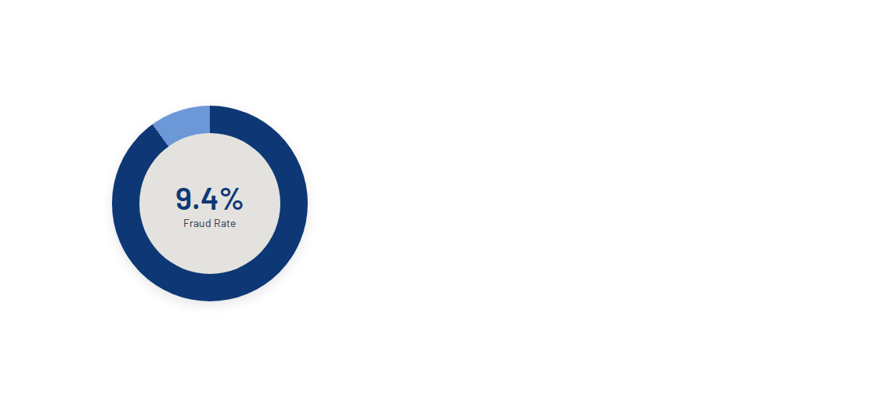
THE 9:1 IMBALANCE
/11
WHY THIS MATTERS
Standard algorithms (like Logistic Regression) optimize for Accuracy.
In this dataset, a "dumb" model predicting No Fraud for everyone achieves 90.6% Accuracy.
Result: 0% Fraud Detection.

Slide 12
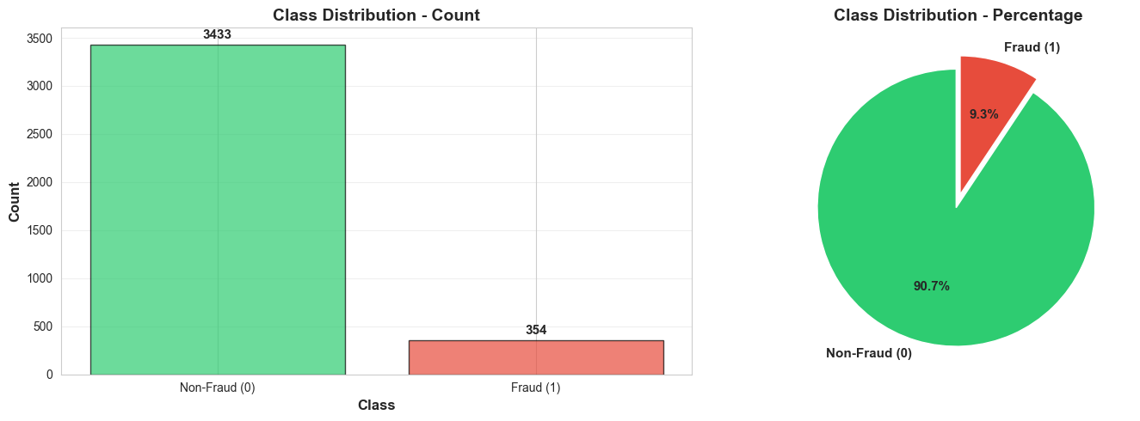
THE 9:1 IMBALANCE
/12
WHY THIS MATTERS
Standard algorithms (like Logistic Regression) optimize for Accuracy.
In this dataset, a "dumb" model predicting No Fraud for everyone achieves 90.6% Accuracy.
Result: 0% Fraud Detection.

Slide 13

SOLVING IMBALANCE
/13
We tested 8 different resampling strategies in our pipeline.
1
SMOTE (Oversampling) Generates synthetic fraud examples by interpolating between existing ones. Good for keeping data volume high.
2
RandomUnderSampler Deletes non-fraud examples. Fast, but loses information. Worked best for SVM.
3
Class Weights Mathematical penalization. Telling the model "One fraud error costs as much as 10 non-fraud errors."
4
SMOTE + Tomek Hybrid approach. Oversamples fraud, then cleans up noisy boundary points.

Slide 14
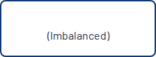
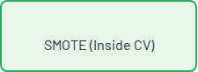
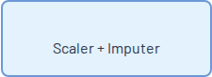

PIPELINE ARCHITECTURE
/14
Input Data
Resampler
Preprocessing
Crucial Detail: Resampling was applied inside the Cross-Validation loop to prevent data leakage.

Slide 15
CANDIDATE ALGORITHMS
/15
Algorithm | Pros | Cons
Logistic Regression | Interpretability, Speed | Fails to capture non-linear fraud patterns.
Support Vector Machine | High Recall (Catch rate) | Computationally expensive, Low Precision.
Random Forest | Robust to outliers, Parallelizable | Struggled with Percision on the minority class here.
Gradient Boosting | Best performance, Iterative correction | Slower training time, Requires tuning.
AdaBoosting | Focuses on hard-to-classify-cases | Sensitive to outliers and noisy data
Decision Trees | Easy to interpret, Fast | Prone to overfitting, Unstable to small data changes

Slide 16
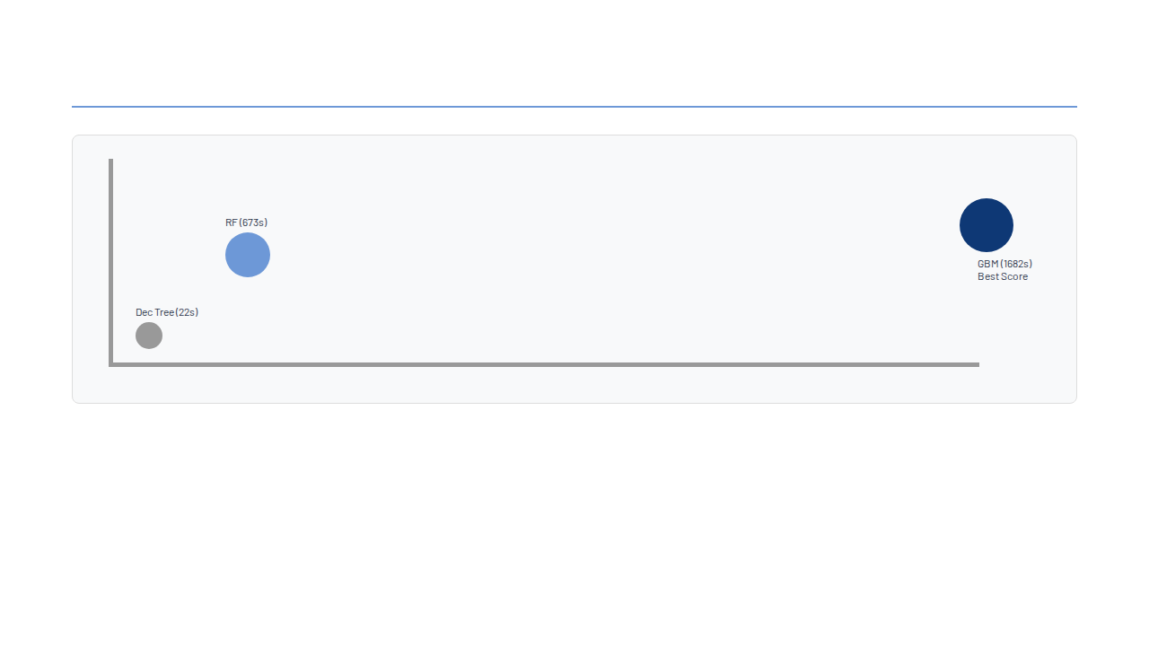
TRAINING EFFICIENCY VS. PERFORMANCE
/16
Tradeoff: Gradient Boosting took ~28 minutes to train (vs 11 mins for RF), but delivered significantly better Recall.

Slide 17

HYPERPARAMETER TUNING
/17
We used GridSearchCV with 5-fold CV to find the optimal settings.
ADA Boosting
ADA Boosting
n_estimators: [50, 100, 200]
n_estimators: [50, 100, 200]
learning_rate: [0.01, 0.1, 0.5. 1.0]
learning_rate: [0.01, 0.1, 0.5. 1.0]
algorithm: [“SAMME”, “SAMME.R”]
algorithm: [“SAMME”, “SAMME.R”]
max_depth: [1,3,5]
GRADIENT BOOSTING GRID
max_depth: [1,3,5]
•
n_estimators: [100, 200, 300]
Winner:
Winner:
50, 0.01, SAMME, 1
50, 0.01, SAMME, 1
•
learning_rate: [0.01, 0.1, 0.2]
•
max_depth: [3, 5, 7]
•
subsample: [0.8, 1.0]
SVM (NoSampling_ClassWeight)
•
min_sample_leaf: [0.8, 1.0]
SVM (NoSampling_ClassWeight)
C: [1, 10, 100]
•
min_sample_split: [2, 5]
C: [1, 10, 100]
kernel: [‘rbf’]
kernel: [‘rbf’]
Winner:
100, 0.01, 3, 0.8, 1.0, 2
Gamma: [“scale” , 0.01, 0.001]
Gamma: [“scale” , 0.01, 0.001]
Class Weight: [“Balanced”]
Class Weight: [“Balanced”]
Winner:
Winner:
1, RBF, Gamma 0.001, Balanced
1, RBF, Gamma 0.001, Balanced

Slide 18



EVALUATION METRICS
/18
RECALL (SENSITIVITY)
PRECISION
PR-AUC
"Of all the actual fraud, how much did we find?"
"Of all the providers we flagged, how many were actually fraud?"
Precision-Recall Area Under Curve.
Target: Primary Metric for Imbalance
Target: MAXIMIZE
Target: BALANCE
ROC-AUC
Reciever Operating CharactaristicArea Under Curve.
Target: Primary Metric for balance

Slide 19
MODEL RESULTS: TEST SET
/19
Model | Recall | Precision | F1-Score | ROC-AUC
Gradient Boosting (SMOTE) | 84.00% | 51.00% | 0.64 | 0.95
SVM (RandomUnderSampler) | 91.00% | 40.00% | 0.55 | 0.95
AdaBoost(No Resampling) | 69.00% | 56.00% | 0.62 | 0.85

Slide 20
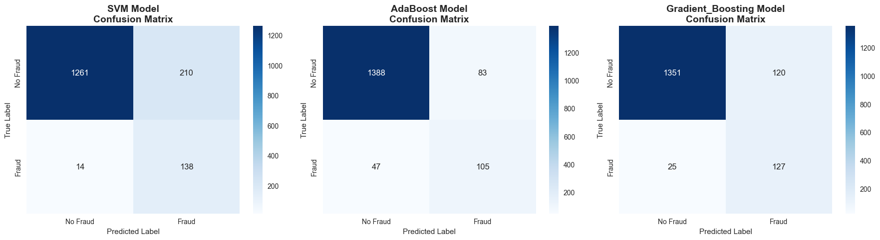
Confusion Matrix
/20

Slide 21
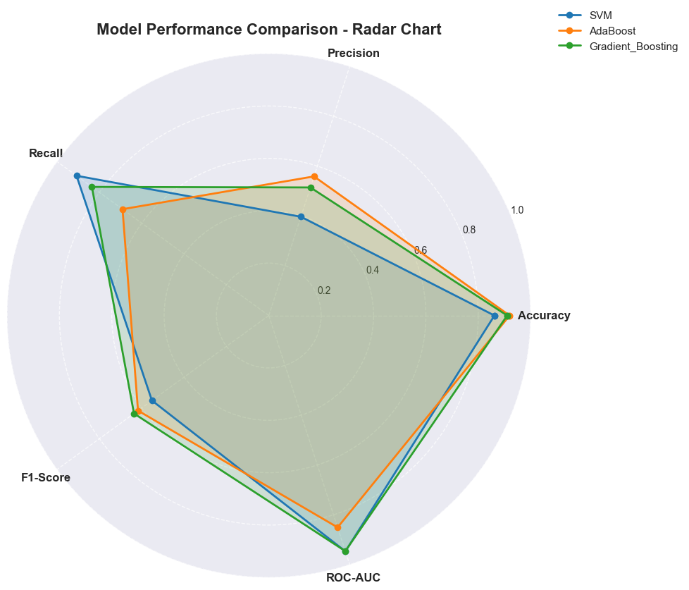
Radar Chart
/21

Slide 22

DEEP DIVE: SVM RESULTS
/22
THE HIGH RECALL TRAP
210
SVM with RandomUnderSampler achieved an incredible 91.0% Recall.
False Positives
However, it achieved this by being "trigger happy".
Precision: 40%
138
This means for every 3 alerts, 2 are false alarms.
Operally unsustainable for manual review teams.
True Positives

Slide 23
DEEP DIVE: ADA Boosting RESULTS
/23
HIGH PRECISION TRAP
74
AdaBoosting with NoResampling achieved an incredible 56.0% Precision.
False Negatives
However, it achieved this by being "Strict".
Recall: 69%
105
“This means for every 10 real fraud cases, the model correctly catches about 7 and misses about 3
True Positives
Operationally dangerous because a large share of fraud slips through undetected.

Slide 24


CHAMPION: GRADIENT BOOSTING
THE GOLDILOCKS ZONE
GBM offers the optimal trade-off.
0.95
84.00% Recall: Misses very few frauds.
51% Precision: 1 in 2 alerts is real.
ROC-AUC Score
0.64 F1-Score: Highest harmonic mean.

Slide 25
DRIVERS OF FRAUD (GBM)
/25
Rank | Feature | Importance Score | Interpretation
1 | ClaimDurationDays_max | 0.69 | Length of stay is the #1 signal.
2 | AttPhys_per_Bene | 0.15 | Sum of attending Physicians per Beneficiary
3 | DiagnosisGroup_Unique | 0.04 | Complexity of cases billed
4 | OtherPhysician_get_mode_count | 0.03 | Highest freq of other Physician

Slide 26



FINAL CONFUSION MATRIX
/26
1351
120
True Negative (Clean)
False Positive (False Alarm)
25
127
False Negative (Missed)
True Positive (Caught)

Slide 27

ERROR ANALYSIS: FALSE POSITIVES
/27
WHY?
THE "Specialized Care Center" EFFECT
•
High-Volume, High-Complexity Facilities
We flagged 120 legitimate providers. Many of them were large, high-volume hospitals whose scale made them look anomalous.
•
They look "anomalous" compared to a small clinic, but are legitimate.
Fix: Normalize features by Bed Count.

Slide 28

ERROR ANALYSIS: FALSE NEGATIVES
/28
WHY?
THE “UNDER-THRESHOLD FRAUDSTER” EFFECT
•
They blend in with legitimate providers by keeping averages normal while manipulating specific categories (e.g., outpatient claims)
We missed 25 fraudulent providers.
These providers showed average billing amounts and normal durations, but hidden patterns (like very high outpatient claims) reveal deliberate masking.
•
Fraudsters intentionally stay just below detection thresholds
(“moderate but suspicious” behavior that avoids extreme outliers)
Fix: Secondary screening for providers with:
High outpatient-to-inpatient ratios
Claims that sit just below alert thresholds

Slide 29
COST ANALYSIS
/30
Algorithm | Total Cost | Cost Per Case | Fraud Losses Prevented | Investigation Cost | Net Savings
Support Vector Machine | $979,000 | $603.20 | $6,900,000 | $348,000 | $5,852,000
Gradient Boosting | $1,433,500 | $883.24 | $6,350,000 | $247,000 | $4,853,000
AdaBoost | $2,485,500 | $1,531.42 | $5,250,000 | $188,000 | $2,712,000

Slide 30
Error Analysis - Business Perspective
False Positives (120 cases - 8.16% of legitimate providers):
- Business Impact: These are legitimate providers incorrectly flagged as fraudulent
- Cost: $1,000 per investigation = $120,000 total
- Risk: Potential provider frustration and delayed claims processing
- Why it happens: Legitimate providers with unusual billing patterns (e.g., specialized care, high-cost procedures)
- Example: A provider handling complex surgical cases with reimbursements of $89,000 looks statistically similar to fraud patterns
- Mitigation: Secondary review process can clear 90%+ of these cases quickly

Slide 31

Error Analysis - Business Perspective
False Negatives (25 cases - 16.45% of fraud):
- Business Impact: Fraudulent providers we miss
- Cost: $50,000 per missed fraud = $1.25 million potential loss
- Risk: This is our highest business risk - fraud continues undetected
- Why it happens: Sophisticated fraudsters who mimic legitimate behavior
- Example: Fraudsters with probability scores of 0.23-0.34 (below our 0.5 threshold) who carefully keep claims just under suspicious thresholds
- Pattern: These cases show similar statistics to legitimate providers (Z-scores within 1 standard deviation)

Slide 32
The Trade-off Decision:
- We chose Gradient Boosting because it minimizes the costliest error (false negatives)
- While SVM catches more fraud (138 vs 127), it creates 210 false alarms vs our 120
- Business rationale: Missing a $50,000 fraud is worse than a $1,000 false investigation
Error Analysis - Business Perspective

Slide 33
Business Value & Impact "Our Gradient Boosting model delivers significant business value to healthcare insurance operations":
Financial Impact:
Net Savings: $4.85 million through early fraud detection
Fraud Prevention: $6.35 million in fraudulent claims caught
Cost Efficiency: $883 per case
balanced investigation costs
Compared to doing nothing, we prevent 127 fraudulent providers from continuing operations
Operational Value:
91% accuracy in provider classification
83.55% recall
we catch 5 out of 6 fraudulent providers
51.42% precision
about half of our alerts are true fraud cases
F1-Score of 0.64
best balance among all tested models
Risk Reduction:
Only 25 missed fraud cases (16.45% false negative rate) - Prevents systemic fraud from spreading -Protects patient safety and healthcare system integrity"

Slide 34
Model Limitations & Business Risks
Performance Gaps:
16.45% false negatives → ~1 in 6 fraud cases missed ($1.25M loss)
8.16% false positives → ~1 in 12 legitimate providers flagged (120 false alarms)
Causes:
Fraudsters mimic legitimate billing
Limited features (billing aggregates only)
Threshold set at 0.5 (business-driven)
Training data may miss new fraud patterns
Risks Accepted:
Some fraud undetected ($1.25M)
Manageable false alarms (120 cases)
Need ongoing monitoring and retraining
Mitigation:
Monthly monitoring, quarterly retraining
Human review of high-risk alerts
Feedback loop improves future models

Slide 35
Recommendations for Model Enhancement
Phase 1: Data Enhancement
Add temporal patterns (seasonality, timing, velocity)
Use network analysis (referrals, patient links, geography)
Impact: 5–10% fewer false negatives
Phase 2: Model Improvements
Ensemble methods (GB + SVM + NN)
Cost-sensitive thresholds, dynamic by provider/claim type
Impact: 10–15% F1-score boost
Phase 3: Deployment & Monitoring
Real-time scoring, A/B testing
Drift detection with alerts
Feedback integration from investigations
Impact: 90%+ recall, <5% false positives

Slide 36

Any Questions ?

Slide 37

THANK YOU

